Slide 1
Crypto Fraud
Information Diamond · Project
Spotting fraudulent crypto transactions before they are released.

Slide 2
The Dream Team
Introducing the dream team
Vadim() #he is a function
Spyros
Manos
Luca

Slide 3
The client and their questions
USER
A fraud analyst at a crypto exchange
1
Which transaction features differ between fraud and clean?
GOAL
Classification: fraud or clean
2
Which account verification level has the most fraud?
DATA
400 flagged transactions, 16 features
Is this new transaction likely fraud, and which past transactions does it look like?
3

Slide 4
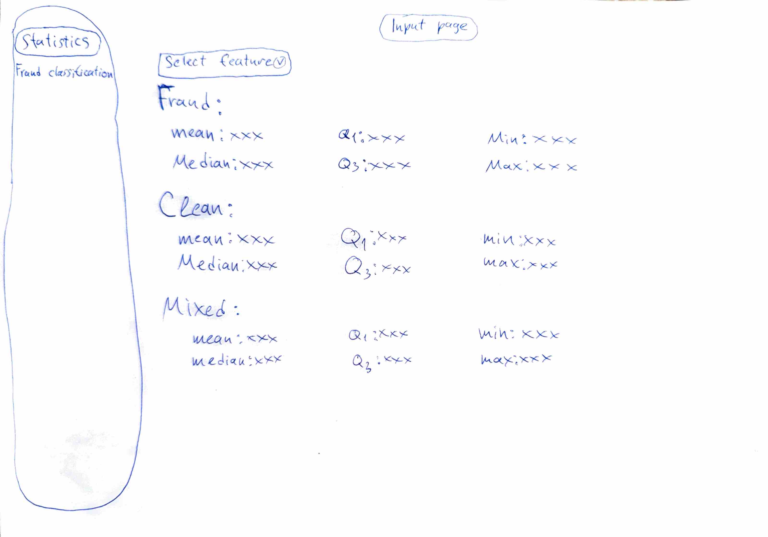
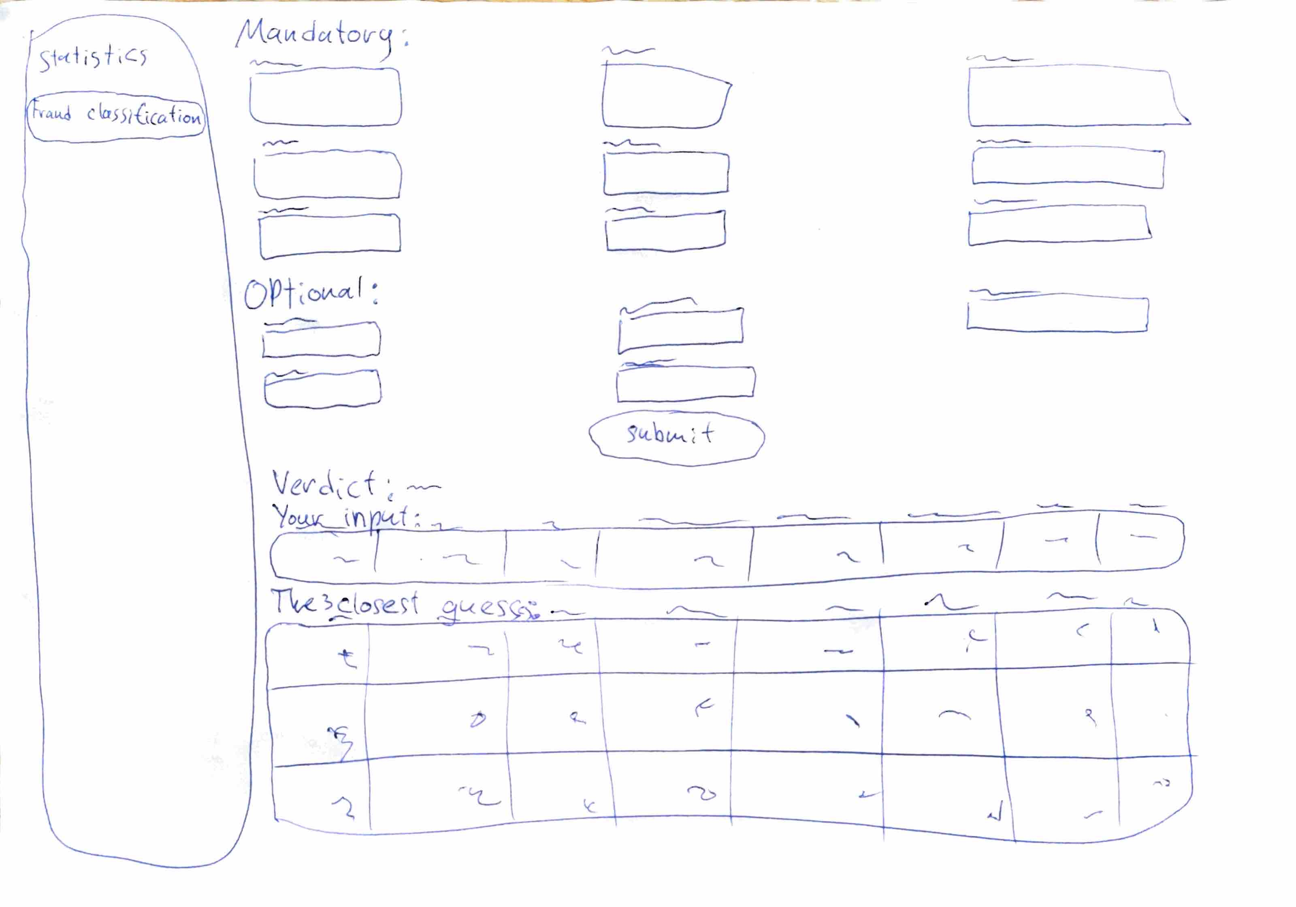
How the app is built
data-5.csv
SQL checks and cleaning
5 features, scaled
KNN, k = 3, saved
Streamlit app
→
→
→
→
Statistics page: pick a feature, compare fraud and clean
Fraud classification page: enter a transaction, get a verdict

Slide 5
What the data told us
400
175 / 225
transactions, 16 features
fraud / clean
0
55%
missing or impossible values
of unverified accounts were fraud (41% basic, 38% full)
Outliers were counted but kept: fraud is often unusual, and every value passed our SQL consistency checks.

Slide 6
The model: KNN with five features
HOW WE CHOSE THE FEATURES
With SQL we compared the average of every column for fraud and clean.
70%
1
2
We kept the columns with a clear difference as candidates.
3
Backward elimination showed that balance change and new address share didn’t help, so we dropped them.
correct on 80 transactions the model had never seen
amount
wallet age
time between transactions
MAE 0.30
spread of that time
KYC tier
KNN with k = 3, features scaled, 80/20 split

Slide 7
Live demo
Step 1
Step 2
Statistics
Fraud classification
Pick a feature and compare fraud with clean transactions.
Enter a transaction, get a verdict and its 3 most similar past transactions.

Slide 8
How we worked
How we worked
Two of us: requirements, design and sketches and frotend
Two of us: data cleaning, SQL and the model
Together: everything joined in one Streamlit app

